Slide 1
Financial Performance & Cash Flow Review (10.5 Months)
Electrical Materials Supply & Solar Services
(Craftship Technical Services)
Prepared by: Nensha Jennifer Dotimi Date: November 2025

Slide 2
Executive Summary
Revenue: ₦119M
Expenses: ₦89M
Profit on Paper: ₦30M
Cash Profit (after removing debtors): ₦22M
Outstanding Debtors: ₦8M
Period Covered: 10.5 months
Key Message: Business is profitable, but cash flow is weakened by unpaid customer debts and high expenses.

Slide 3
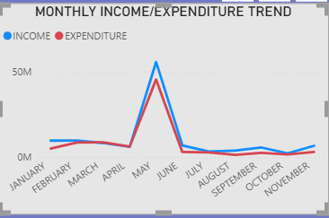
Revenue Overview
Total Revenue: ₦119,000,000
Strong demand from inverter services & electrical supply
Revenue is healthy for 10.5 months
Line Chart (from Power BI screenshot)

Slide 4
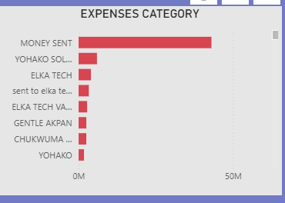
Expense Overview
Total Expenses: ₦89M
Expense Ratio = 75% of revenue
High cost structure affecting profitability
Bar Chart — Expenses by Category

Slide 5
Profit Analysis
Profit Before Debtor Adjustment: ₦30M
Cash Profit (Actual Money Received): ₦22M
Insight: ₦8M unpaid reduces real profit by 26%.

Slide 6
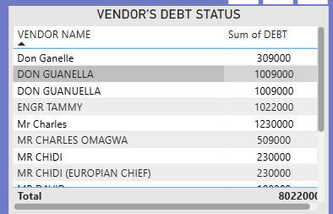
Debtors Analysis
Total outstanding debts: ₦8M
Equals 6.7% of revenue
Cash trapped in customer credits
Serious impact on daily operations
Debtor table from Power BI

Slide 7
Key Issues Identified
🔥 1. High expenses (75%)
🔥 2. Weak debtor management (₦8M unpaid)
🔥 3. Profit mostly on paper, not cash
🔥 4. No structured credit control

Slide 8
Recommendations
1. Improve debtor recovery • Follow-up schedule • Settlement discounts • Stop supply to chronic debtors
2. Reduce expenses by at least 10–15%
3. Increase high-margin services • Maintenance contracts • Battery replacement plans
4. Introduce a credit policy • Credit limits • Maximum 30-day terms

Slide 9
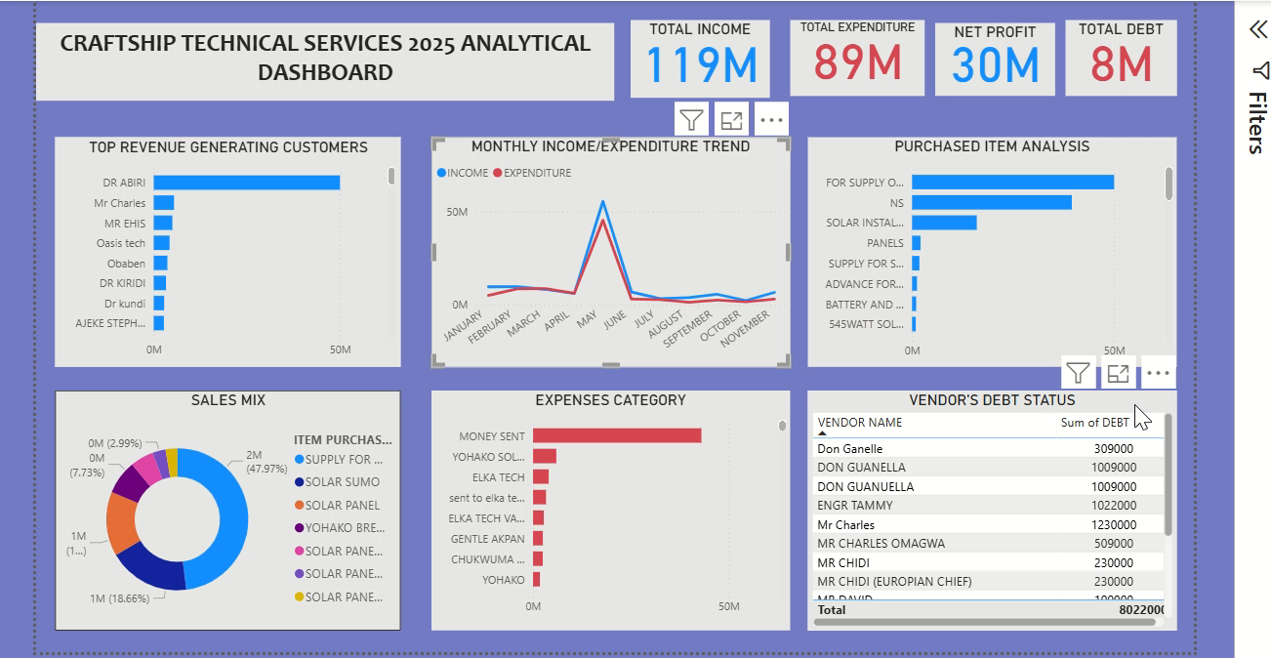
Power BI Dashboard Presentation

Slide 10
Conclusion
Business is profitable
Cash flow must be strengthened
Debtors must be aggressively recovered
With better cost control, next-year profit can rise by 40–50%
Thank you.

